Slide 1

Project Status Check
22.3.2024
InnovateForge Solutions T18

Slide 2

CURRENT STATUS OF TEAM WORK
We get along well with the team
Internal communication of the team has been fluent so far
No major problems or issues so far in the team

Slide 3

STATE OF THE PROJECT
Recently we have gotten Tukko working fully in cPouta and started working on our first new features like authentication securely to the web app with user accounts
Some problems have been encountered with the Tukko backend
Planning on future features and how to execute them
We have also been studying about test automation

Slide 4
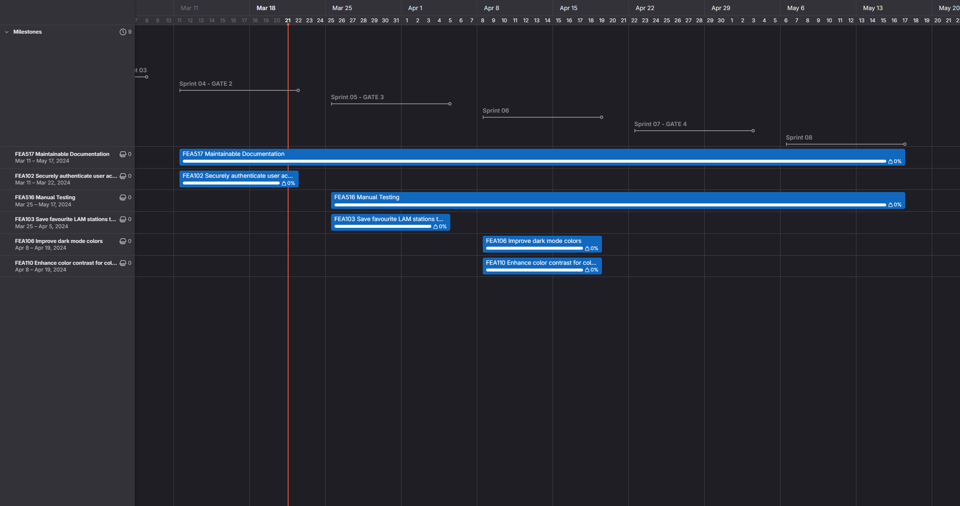
ROADMAP

Slide 5

PRICING AND WORKING HOURS
Over 450 hours spent in total on the project at this point
Total price € 81,396.08 (incl. VAT 24%)
FEA102 Securely authenticate user accounts AND FEA103 Save favourite LAM stations to user account should be ready for DEMO 15.4.2024

